Slide 1


Etiquettes to crack the FSD interviews and Road Map to Reach High Pay Employability
General Instructions
The Roles, Responsibilities, and Career Opportunities.
Trending Tools and Tech Stack for upskilling
What Industry demands on you vs Market
How to brand yourself
Problem solving
Tech stack
Why FSD
Culture Fit and Ethics
Projects and Portfolio
Harishankher Selvaraj
Talent Lead - MBC (ZEN - FSD)
GUVI Geeks Network Pvt Ltd
IIT- M Research Park
Taramani Chennai
01

Slide 2
CTO
(Chief Technological Officer)
VP of Engineering
Engineering Manager
Team Lead
Coder

Slide 3
There is no age restriction to jump from one stage to other. It's all about understanding, more you understand the pattern , more you fly high.

Slide 4

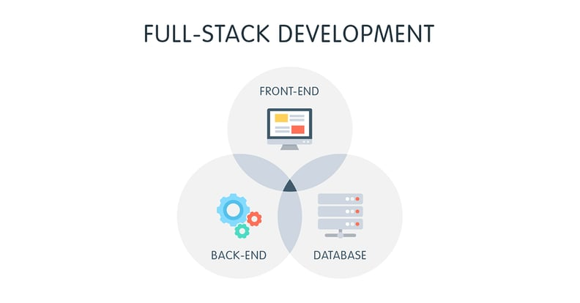
FSD

Slide 5
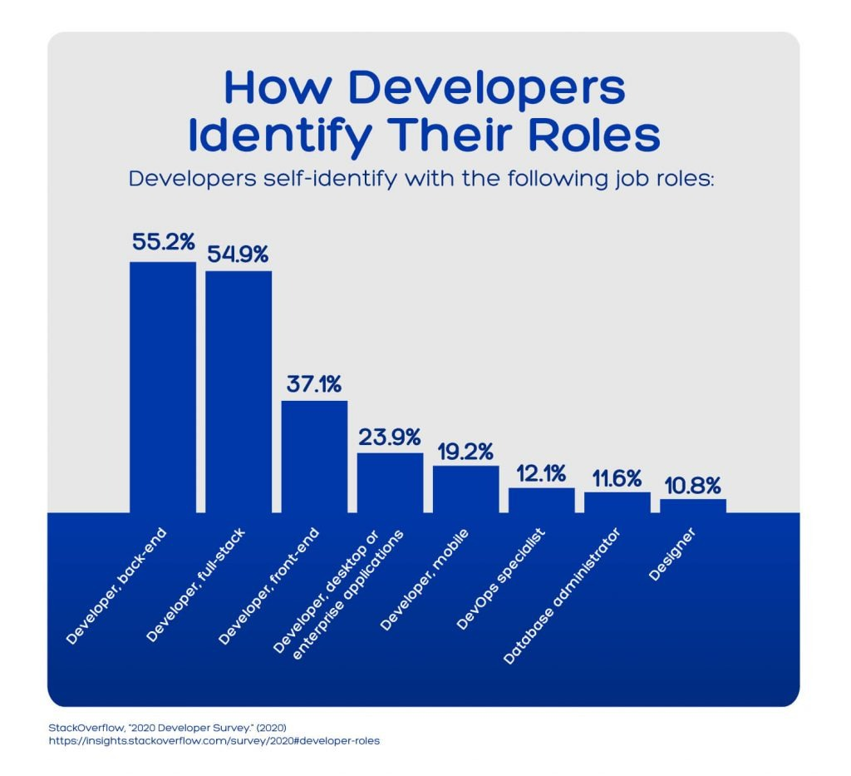
UX Developer
UI Developer
Front End Developer
Back End Developer
Devops Specialist
DB Administrator

Slide 6
FSD Road Map
Internet Fundamentals
HTML/CSS Fundamentals
Java Script
Chrome
DevTools
Testing
Java Script
Framework
NPM & YARN
Version Control System
git/github
Linux
Fundamentals
Programming Languages
Database
Web Security
Cloud Service Provider
Caching
CI/CD
02

Slide 7
Step by Step FSD Learning
Lazy Loading in React
Portals in React
State Management in React
Routing in React
Theming in React
Patterns in React
Anti-Patterns in React
Linux Administration
Testing Skills
What to learn before FSD developer
Introduction to API
using API - AXIOS / Fetch
Usage of React Memo call
Wapping Lazy Loading by Using Suspense Components
Diffing Algorithm
Bundlers - Webpack - Grunt - Browserify
React Mixins
React Helmet
React Fiber
React Portal
CI/CD
Cloud Skills
Deployment skills
What to learn as a beginner to FSD
How to move as a beginner to intermediate FSD developer
Git Version Control
HTML
CSS
Bootstrap
JavaScript, Database
Programming
NPM Ecosystem
How to Deploy, Host, and Make your App Public:
Set Up your Development Environment
Learn about JSX
Learn about React Components
State and Props in React
Lists and Keys in React
Life Cycle Methods in React
MYSQL & MongoDB
How to move as a intermediate to Advanced FSD developer
Styling in React
Form Handling in React
Data Handling in React
Reconciliation Process in React
React Hooks
Custom React Hooks
Context in React
Node JS Libraries
NPM Packages
Express JS
Who is Advanced FSD developer
03

Slide 8
Javascript is the NO. 1 Programming Language
Console Application
Web & Mobile Application
IOT
Computer Vision
Games
Data Science
Cloud Deployment
Freshers – 2 Years Experience
4 Lakhs - 20 Lakhs

Slide 9
Strategies to Crack a FSD Interview
HTML CSS
Javascript Programming & Problem solving - Using Built in Functions & ES6
API Calls - Useeffect(),axios(),fetch(),query builder
MYSQL and Mongodb Querying
Node JS Libraries
Framework Knowledge

Slide 10
ES6 Features
let and const Keywords Arrow Functions Multi-line Strings Default Parameters Template Literals | Destructuring Assignment Enhanced Object Literals Promises Classes Modules
Reference : www.boardinfinity.com/blog/top-10-features-of-es6/#1-let-and-const-keywords-

Slide 11
ES7 Features
Exponentiation Operator Async functions Async generators Object.getOwnPropertyDescriptors Object.values Object.entries Array.prototype.includes Typed Objects Trailing commas in function syntax. Class decorators. Class properties Map.prototype.toJSON | Set.prototype.toJSON String.prototype.at Object rest properties Object spread properties String.prototype.padLeft String.prototype.padRight String.prototype.trimLeft String.prototype.trimRight Regexp.escape Bind Operator Reflect.Realm
Reference : https://github.com/vendethiel/es7-features#arrayprototypeincludes

Slide 12
Built-in Functions - JS
Number Methods : constructor() toExponential() toFixed() toLocaleString() toPrecision() toString() valueOf() | Boolean Methods : toSource() toString() valueOf() | String Methods : charAt() charCodeAt() concat() indexOf() lastIndexOf() localeCompare() length() match() replace() search() slice() | split() substr() substring() toLocaleLowerCase() toLocaleUpperCase() toLowerCase() toString() toUpperCase() valueOf()

Slide 13
String HTML wrappers
anchor() big() blink() bold() fixed() fontcolor() fontsize() italics() link() small() strike() sub() sup()

Slide 14
Array Methods
concat() every() filter() forEach() indexOf() join() lastIndexOf() map() pop() push() | reduce() reduceRight() reverse() shift() slice() some() toSource() sort() splice() toString() unshift()

Slide 15
Date Methods
Date() getDate() getDay() getFullYear() getHours() getMilliseconds() getMinutes() getMonth() getSeconds() getTime() getTimezoneOffset() getUTCDate() getUTCDay() getUTCFullYear() getUTCHours() getUTCMilliseconds() getUTCMinutes() getUTCMonth() getUTCSeconds() getYear() | setDate() setFullYear() setHours() setMilliseconds() setMinutes() setMonth() setSeconds() setTime() setUTCDate() setUTCFullYear() setUTCHours() setUTCMilliseconds() setUTCMinutes() setUTCMonth() setUTCSeconds() setYear() | toDateString() toGMTString() toLocaleDateString() toLocaleFormat() toLocaleString() toLocaleTimeString() toSource() toString() toTimeString() toUTCString() valueOf() Date Static Methods Date.parse( ) Date.UTC( )

Slide 16
Math Methods
abs() acos() asin() atan() atan2() ceil() cos() exp() floor() log() max() min() pow() random() round() sin() sqrt() tan() toSource()

Slide 17
RegExp Methods
exec() test() toSource() toString()

Slide 18
React Core Components
React Hooks - State Hook - Effect Hook - ESLint Plugin - Building Own Hooks
{useState, useEffect, useReducer, useContext}
State Management
- Most Popularly Used Redux, MobX, and the built-in Context API
State Management with libraries
- Recoil - Jotai - Redux - Rematch - Zustand - Hook State

Slide 19
API Calls
Front End API Calls
Web API calls - get - post - delete - patch
Using Promises - async & await
Call The API with Fetch - Call The API with Axios
Back End API Calls
Node JS - HTTP - Request - AXIOS - Super Agent - Got - Back End

Slide 20
NODE JS - Libraries
Express JS CORS Multer Socket Io Body Parser Moongose Jest validator JSDoc Node Mailer AXIOS MORGON | passport dotenv http tillio Mailchimp Sendgrid Lodash Libuv Moment geo-ip request-ip

Slide 21
MYSQL & MONGODB
Know to use MYSQL - Raw Queries
Using Prefetched Queries using MYSQL
Using Prefetched Queries using Mongo
Other Things to concentrate :
Basic System Design - DB Design

Slide 22
Skill Set
Mathematical Ability
Problem-solving skills
Creativity & Innovation
Interpersonal skills.
Commercial awareness

Slide 23


Slide 24


Slide 25


Slide 26
Ethics
Know to Say “NO” in Corporate
Concern & respect for others
Design for privacy, security and integrity
Honesty & trust worthy
Ensure the responsibilities and opportunities
Commitment to excellence & accountability
Capability to review something and saying this is right Or wrong

Slide 27


Slide 28


Slide 29


Slide 30
We're done!
Thank you for participating. Have a great day ahead.
Page number

